Slide 1
ATE Targeted Research in Action:
FLATE/PathTech and Fox Valley/METTE
Partnerships to Improve Student Outcomes
Presenters:
University of South Florida
Will Tyson, PI
Lakshmi Jayaram, co-PI
Edward Fletcher, co-PI
Fox Valley Technical College
Patricia Frohrib, co-PI
University of Wisconsin-Madison
L. Allen Phelps, PI

Slide 2
Introductions: PathTech Team and METTE Team
Workshop Overview
The ATE Targeted Research Priority
Why Targeted Research on Technician Education Matters
The National College Completion Agenda
State Level Performance Funding (WI and FL)
Local college initiatives (FVTC)
Strategic Planning
Program Improvement and Performance Scorecards
To focus our remarks: What information, if available, would be most useful for improving ATE student success or outcomes?
Notes:
(5-8 minutes)
Brief, self introductions
Patti to develop additional slides and slides
Invite the Audience to Identify 2-3 significant “knowledge gaps”

Slide 3
Mixed Methods Research Design
Quantitative
Education and employment administrative data
Institutional, state, and national public and private data sources
Study transition from high school and the workforce into advanced technologies
Study short-term and long-term post-schooling outcomes
Notes:
(5-8 minutes)
Brief, self introductions
Patti to develop additional slides and slides
Invite the Audience to Identify 2-3 significant “knowledge gaps”

Slide 4
Mixed Methods Research Design
Qualitative
In-depth understanding of educational and employment experiences through open-ended questions
Opportunity to gather data from sources not typically included in large datasets (e.g. administrators and employers)
Ability to articulate a process using personal histories to construct school-work trajectories
Notes:
(5-8 minutes)
Brief, self introductions
Patti to develop additional slides and slides
Invite the Audience to Identify 2-3 significant “knowledge gaps”

Slide 5
ATE Center/University Partnership
FLATE Regional Center of Excellence/University of South Florida
(Tampa, FL)
Notes:
PathTech designs, creates and fosters collaborations that allow for organic development of research objectives and processes where knowledge is constructed and produced through interface and interaction with those experiencing technician educational and occupational pathways as administrators, teachers, students, employers, and policy makers. These collaborations allow for real-time dissemination of emerging findings and developing knowledge, which allows all collaborative members to benefit from the research.

Slide 6
Hillsborough Community College (Tampa)
Advanced Manufacturing
St. Petersburg College (Clearwater)
Biomedical Systems, Quality,
Digital Design & Modeling
Polk State College (Lakeland)
Advanced Manufacturing
State College of Florida (Venice)
Electronics, Digital Design & Modeling

Slide 7
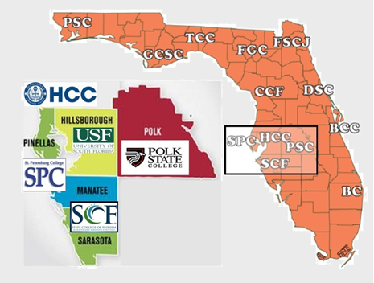
FLATE Engineering Technology College Network

Slide 8
FLATE connects USF researchers to Tampa Bay area ET community
ET students
ET graduates
High school career academies
Industry partners

Slide 9
Primary Research Objectives:
Understanding recruitment and pathways into ET
Providing information to improve ET education
Increasing the visibility of ET programs
Providing information to help meet workforce demands

Slide 10
Pathways Research Model
Individuals transitioning from school to work often simultaneously experience other life transitions
Fewer and fewer students experience a linear progression from school to work, or a “pipeline”.

Slide 11
Quantitative Goals
Data: Education and employment data from Florida Department of Education PK-20 Education Data Warehouse of Tampa Bay high school graduates
Identify a profile of HS students who enroll in ET and other manufacturing programs
Compare educational and employment outcomes among comparable students

Slide 12
Student Profiles
Mean high school GPA by degree program
Manufacturing students are comparable to AA and AS/AAS students and STEM majors are comparable to other BA/BS students with only slightly higher math and science grades.

Slide 13
Student Profiles
Math coursetaking by degree program
Manufacturing students are least likely to take Pre-calculus or Calculus.

Slide 14
Student Profiles
Science coursetaking by degree program
Manufacturing students take science courses at a comparable rate as non-STEM BA/BS students.

Slide 15
Student Profiles
Percent Female by degree program
Women make up about a quarter of students who enrolled in Manufacturing programs compared to almost half of STEM programs.

Slide 16
Qualitative Goals
Interviews and focus groups
College students, faculty, and administrators
High school students and personnel
Employers and key stakeholders
Reveal alternative ET pathways, particular because ET students generally come from the workforce

Slide 17
Emergent Pathways
AA/AAS degree
Work (Manufacturing or Electronics)
Community College ET Course Taking
Employment
Better Pay
Better Job
Job Promotion
High School
Family & Relationships
Bachelor’s Degree

Slide 18
Factors that Influence ET Enrollment
Life Experiences:
Inclinations
Education
Work
Information Flows
Motivations:
Education
Better Job
Higher Income
Security & Stability
Mobility
“How” Information Flows About ET Programs
Friends
Colleagues
Websites
Recruiters
“What” (Mis)information Flows is Shaped By
Teachers (+)
HS Counselors (-)
Confusion about Engineering vs. ET (-)

Slide 19
Improving Educational Outcomes in Manufacturing Engineering Technologist and Technician Education
Research and Innovation Partnership to Improve Student Success
Five Partners: UW-Madison, FVTC, MATC-Milwaukee, MPTC, and WCTC
Student Success Model
Research and Innovation Framework
Notes:
offer 35 of Wisconsin’s METTE 54 associate degree and technical diploma programs. Annually, METTE programs at these four colleges serve more than 3,000 students or about 40% of METTE program enrollees in Wisconsin’s technical colleges.

Slide 20
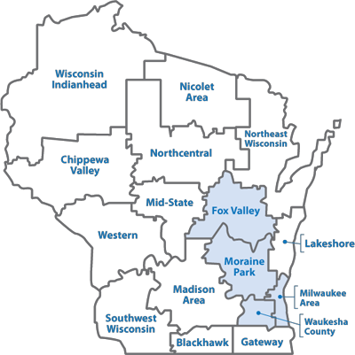
Notes:
Manufacturing is the largest industry sector in WI’s economy, employing near
These four colleges offer 35 of Wisconsin’s METTE 54 associate degree and technical diploma programs. Annually, METTE programs at these four colleges serve more than 3,000 students or about 40% of METTE program enrollees in Wisconsin’s technical colleges.

Slide 21
Two Guiding Questions:
What are the specific METTE program features that are associated with optimal student outcomes?
How can key METTE stakeholders use research data and findings to inform strategic program improvement decisions?
Notes:
offer 35 of Wisconsin’s METTE 54 associate degree and technical diploma programs. Annually, METTE programs at these four colleges serve more than 3,000 students or about 40% of METTE program enrollees in Wisconsin’s technical colleges.

Slide 22
METTE Student Success Model
Notes:
Initial Model in our proposal based on student development ( ) and social-cognitive career theory (Lent, Brown and Hackett)
Model has changed from our collaborations: (a) WTCS mission is predominately workforce development, so LM outcomes are getting more attention, (b) college and career readiness, common core curriculum, and importance of precollege experiences led to modifications in the HS factors we are studying.

Slide 23
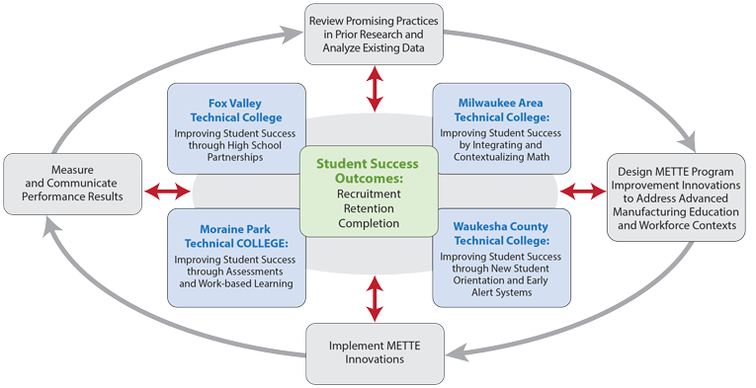
Research and Innovation Framework
Local Leadership Team
V-P for Instruction
MFG &ENGR Dean
Institutional Research Office
UW Mad Researcher
Networked Improvement Communities
Local Leadership Team
Associate Deans
Faculty Leaders
Inst. Research Analysts

Slide 24
METTE at FVTC
Improving Student Success Through High School Partnerships
2013-16 Strategic Priority:
Increase by 10% each year the number of high school graduates who enter FVTC programs with prior FVTC credits (2012 Baseline: 13.4%)
Research Questions
In what ways do school-level and student-level characteristics influence students’ early success at FVTC?
Do school-level measures have an effect above and beyond their corresponding student-level measures?

Slide 25
PROJECT OUTCOMES
Provide each high school community with a report describing their graduates’ success at FVTC and beyond.
2. Create a baseline for documenting and tracking the effects of various FVTC Early Career Success partnership projects:
Career Jump Start—Machine Tool (3 new dual credit courses in 5 high schools during 2013-14)
Dual Credit Summer Teaching Academy (2013--5 CTE inst.)
Completion of ACCPLACER by all students in Grade 11
New academy development -- manufacturing, technical or engineering
3. Benchmark the effectiveness of high school partnership linking practices

Slide 27
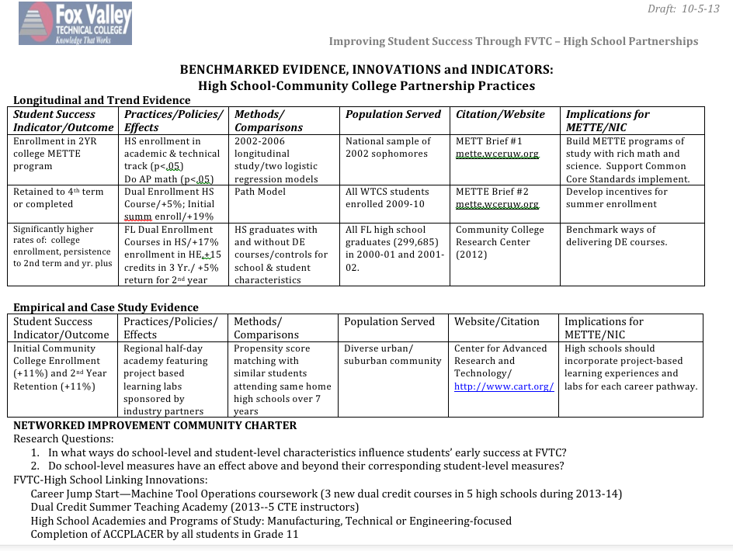

Slide 28
Some Early Findings
Aspirations and Enrollment in STEM Fields
From a national sample of 2002 high school graduates, we found:
• Students who described themselves as being in both the academic & occupational tracks in high school were more likely to enroll in manufacturing programs instead of other STEM fields.
• Having at least one advanced placement (AP) math credit in high school was associated with 70.3% (girls) or 25.8% (boys) more likely to aspire to manufacturing fields, and 44.2% (girls) and 7.6% (boys) more likely to actually enroll in manufacturing fields at two-year colleges.
Source: Students in Manufacturing and Other STEM Fields at Two-Year Colleges: An Exploration of Aspirations and Enrollment (Spring 2012)

Slide 29
Some Early Findings
For recent high school grads who attended one of the technical colleges in Wisconsin in 09-10 academic year, we found that:
• Summer enrollment in 2009 is the strongest predictor of future educational success: Students who took summer courses were 19% more likely to be retained at the 4th term or to graduate earlier than their counterparts.
• Students who experienced delayed entry to college were 6% less likely to be retained or graduate at the 4th term.
Source: The Influence of Dual Enrollment and Early Academic Momentum on Two-
Year Technical College Student Success (AERA, April, 2013)

Slide 30
Discussion Questions:
How can longitudinal data be used to evaluate ATE projects, program improvements, program innovations, and to track student progress?
In what ways can qualitative research methods (e.g., interviews and focus groups with students, instructors, and industry partners) clarify the importance of engineering technology (ET) programs, understand the factors affecting ET students’ decisions, and enhance our understanding of the challenges and transitions encountered in different settings by increasingly diverse students?
When integrated, how can mixed methods of targeted research improve student outcomes and success in ATE pathways?

Slide 31
WEB-BASED RESOURCES FOR ATE PROJECTS
PathTECH http://sociology.usf.edu/pathtech/team/
METTE http://mette.wceruw.org/
Evidence-Based Innovations
CCSSE http://www.ccsse.org/center/
Policydirect.org http://www.policydirect.org/
OCCRL http://occrl.illinois.edu/
NRCCTE http://www.nrccte.org/
Teaching Technicians – Proven and Promising Practices
https://www.teachingtechnicians.org/Resources/PPP/
CCRC http://ccrc.tc.columbia.edu/
CAPSEE http://capseecenter.org/

